Slide 1
Data Analysis in Sociology
Saint-Petersburg 2026
Seminar 3
Ilya lyapin

Slide 2

Quote/event of the week
Saint-Petersburg 2026

Slide 3

Plan for today
Saint-Petersburg 2026
Simple linear regression
Multiple linear regression
Interaction effects
Practice

Slide 4
Simple Linear regression
Saint-Petersburg 2026
Key assumptions, meaning behind it and application

Slide 5
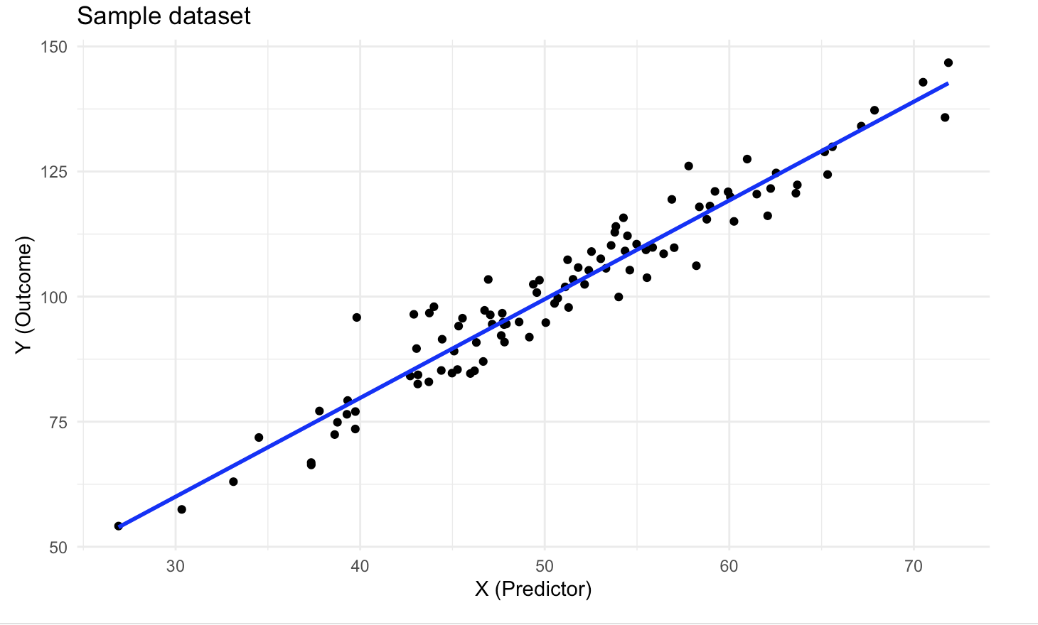
Linear regression
Saint-Petersburg 2026
Linear regression - a statistical model that tries to describe data by fitting it into the line

Slide 6

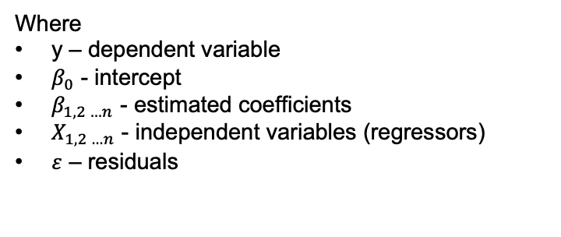
Linear regression
Saint-Petersburg 2026
 | Simple regression | Multiple regression
Formula
Meaning | Describes simple relationship between one variable and the other | Describes relationship between one variable and many other variables

Slide 7
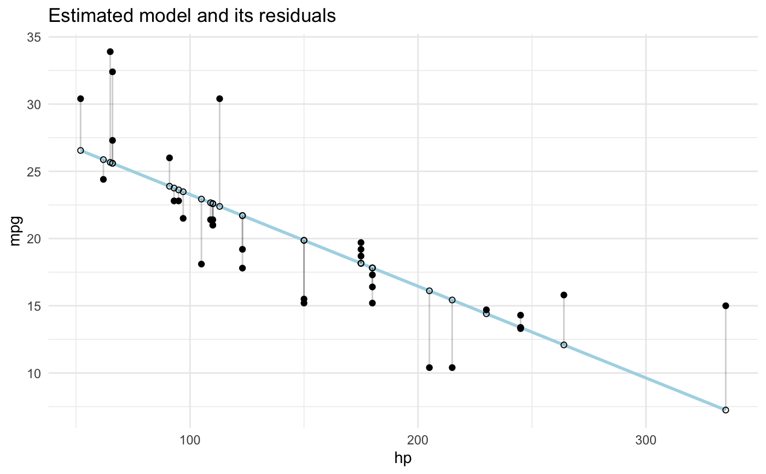
Linear regression
Saint-Petersburg 2026
What are residuals?

Slide 8
Linear regression
Saint-Petersburg 2026
What are residuals?
Differences between actual and estimated values
residuals

Slide 9
Linear regression
Saint-Petersburg 2026
Linear regression requires some assumptions to be met:
Linearity
Normality of residuals
Homoscedastiy of residuals
Independence
No multicollinearity (for multiple regression analysis)

Slide 10
Linear regression
Saint-Petersburg 2026
Linearity assumption can be checked with a simple scatterplot

Slide 11
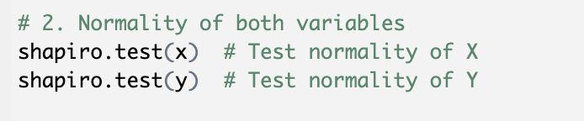
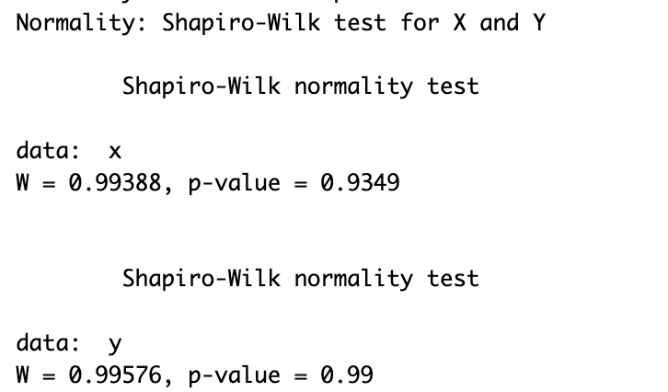
Linear regression
Saint-Petersburg 2026
Normality of data can be assessed via Shapiro-Wilk test:
H0: The data is normally distributed (p-value > 0.1)
H1: The data is not normally distributed (p-value < 0.1)

Slide 12
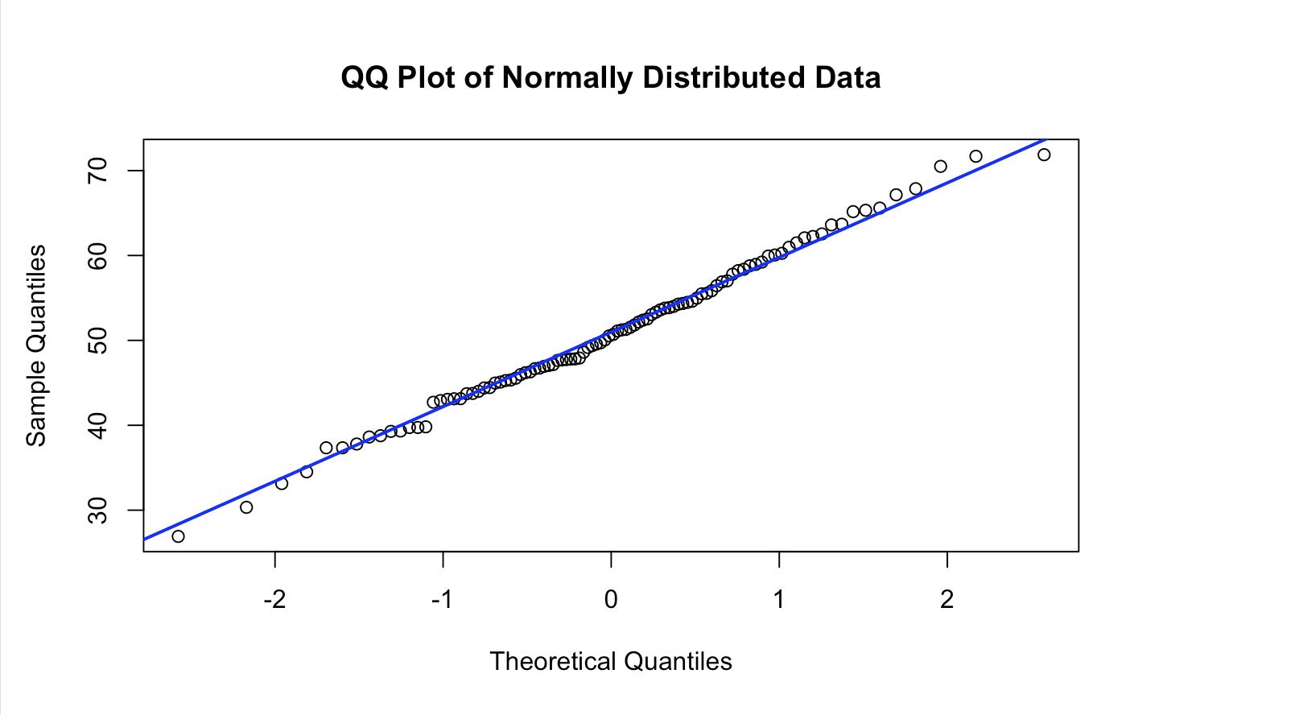
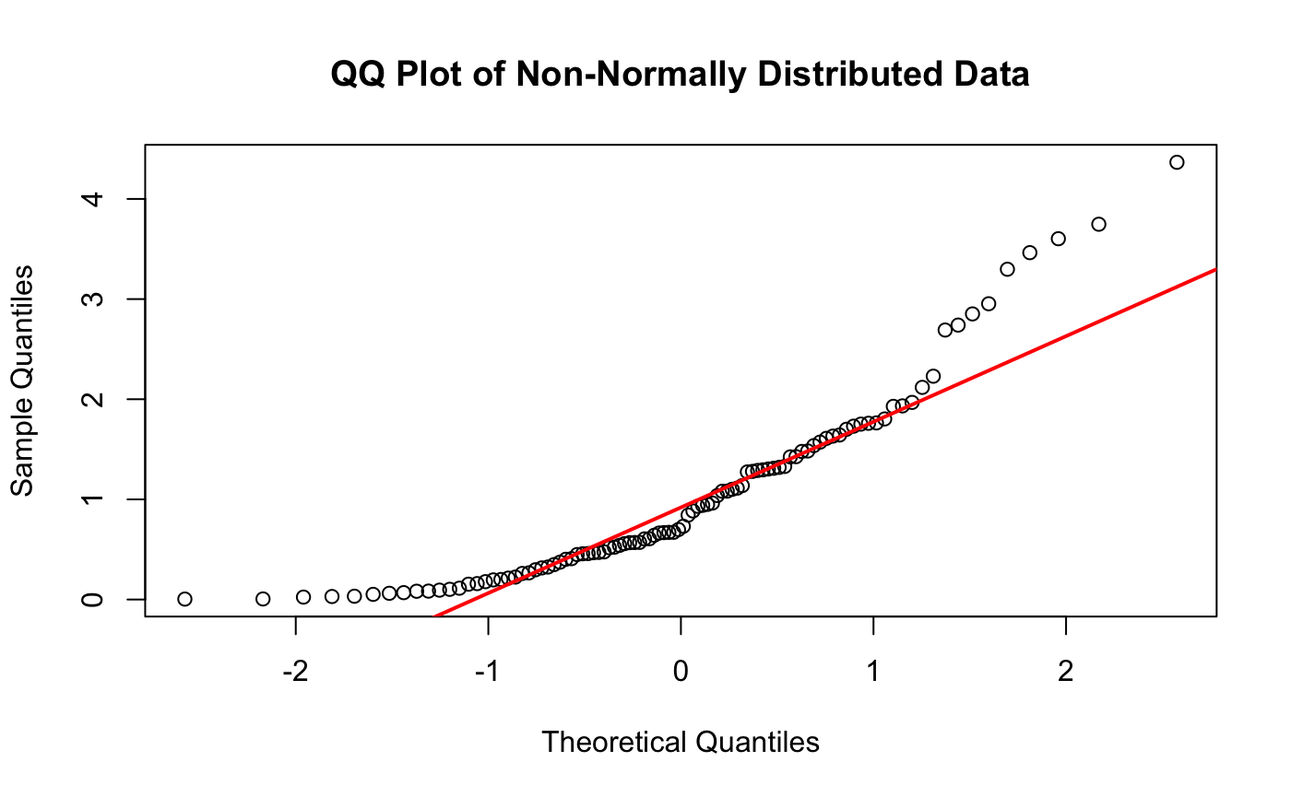
Linear regression
Saint-Petersburg 2026
Or you can build a QQ-plot
It compares theoretical quantiles of a normal distribution with sample quantiles

Slide 13
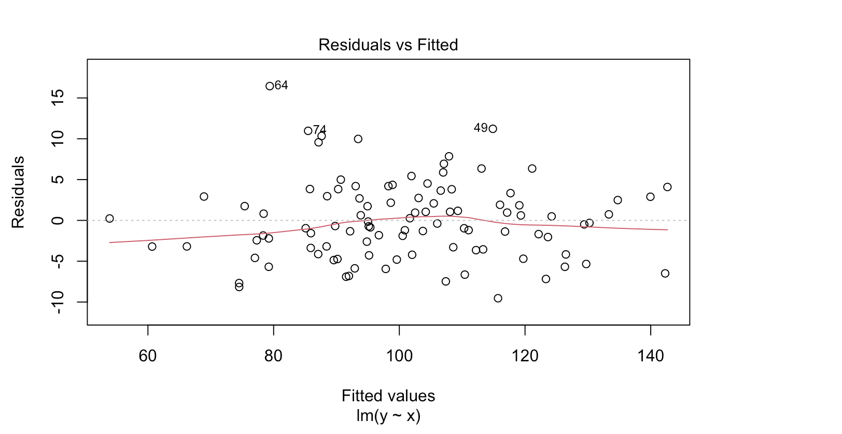

Linear regression
Saint-Petersburg 2026
Homoscedasticity can be checked by plotting residuals of the model and estimated (fitted) values of the model.
This data should not follow a pattern and be consistently distributed

Slide 14
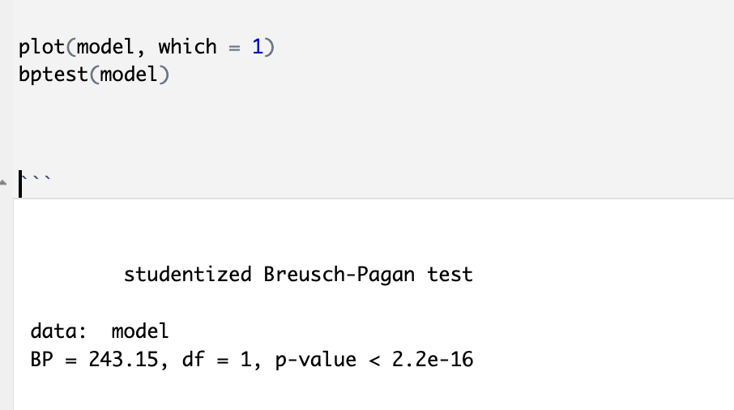
Linear regression
Saint-Petersburg 2026
Or you can check for homoscedasticity by conducting Breusch-Pagan test
(H0): Homoscedasticity is present (the residuals are distributed with equal variance)
(HA): Heteroscedasticity is present (the residuals are not distributed with equal variance)

Slide 15
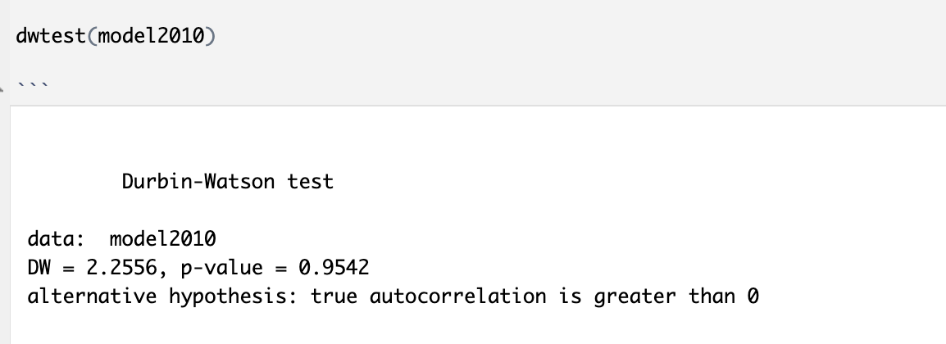
Linear regression
Saint-Petersburg 2026
Or you can check for independence by conducting Durbin-Watson test
H₀: Residuals are not autocorrelated
(no serial correlation)
H₁: Residuals are autocorrelated (either positively or negatively).

Slide 16
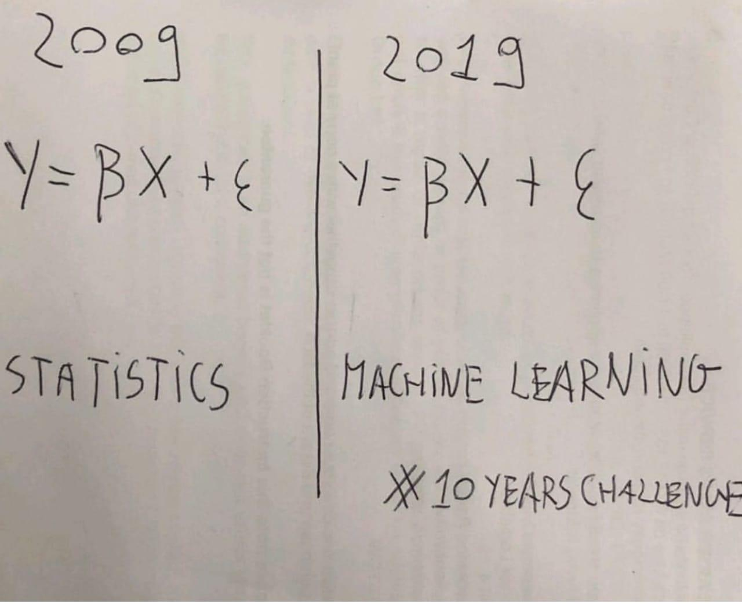
Statistical models VS Machine learning models
Saint-Petersburg 2026

Slide 17
Statistical models VS Machine learning models
Saint-Petersburg 2026
Properties | Highly interpretable Strong assumptions Explains things | Barely interpretable Almost no assumptions Makes accurate predictions
Examples | Linear Regression, Logistic regression, ANOVA | Random forest, Gradient Boosting, Neural Networks
Statistical models
ML models

Slide 18
Interaction effects
Saint-Petersburg 2026
What they mean and why include them

Slide 19
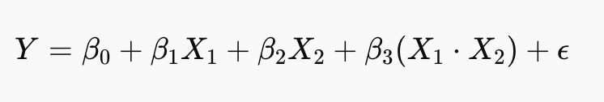
Interaction effect
Saint-Petersburg 2026
We may want to include interaction effects into the model if we want to estimate the joint effect of contributing to the target variable

Slide 20
Interaction effect
Saint-Petersburg 2026
Why add them?
Real world processes are rarely explained solely by independent contribution, more often they work complexly and contribution is not independent. Adding interaction term to the model may help us do this

Slide 21
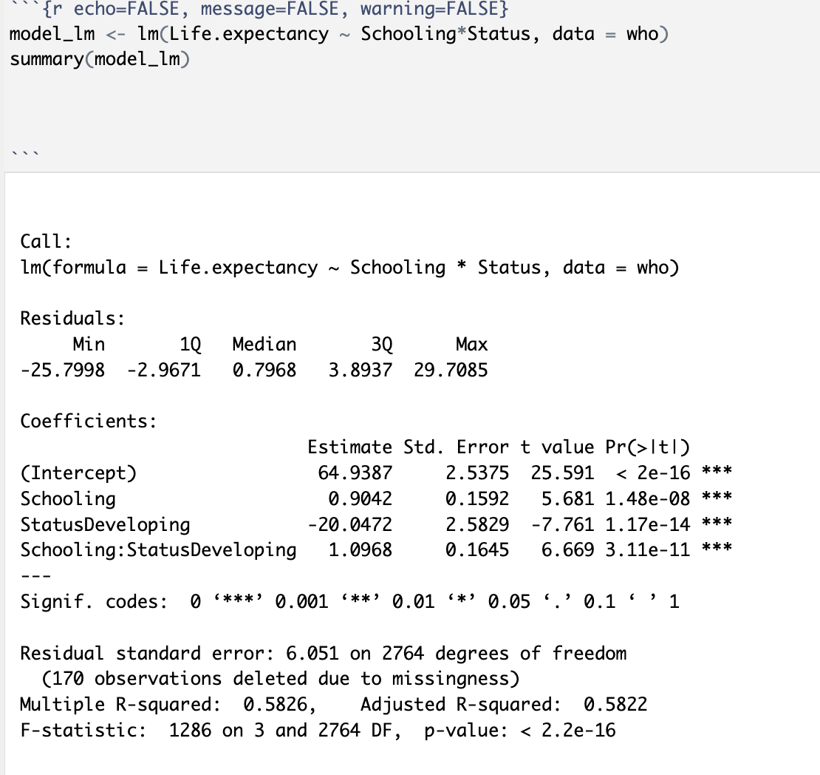
Interaction effect
Saint-Petersburg 2026
Example in R

Slide 22

Saint-Petersburg 2026
Thank you for attention!

